Slide 1
Task Management & Organizational Tools
Graduate Workshop Linguistics Department
April 7, 2025
Presenters: Amy Atiles, Chae Eun Lee,
Britni Moore, Sidney Wong
Welcome

Slide 2
Tools Discussed
Zotero
Notion
Obsidian
Overleaf
Google Co-Lab
Notes:
… except for also Jurism

Slide 3
Citation Managers are NOT Optional
…and other opinions that no one asked for

Slide 4
Zotero and Mendeley and Endnote… Oh My!
I like free stuff
Zotero and Mendeley are free to use
(with paid options)
Mendeley bites
Endnote costs $$$
(boooo!!!!)
Notes:
Do as you will, but the rest of this presentation will only talk about Zotero

Slide 5
… or maybe Jurism
Jurism is Zotero for
Legal Citations
Citing in Multiple Languages
Notes:
… except for also Jurism

Slide 6
Why? What’s the Point?
Or Any Other Stupid Question
Keep Track of Citations/Readings
Autosave Citations
Annotate!!
Insert Live In-Text Citations
Create Live Bibliographies
Share Your Shit
All this and more for the low low price of free

Slide 7
Organize Your Citations
Libraries and Collaboration
Collections and Sub-Collections
Attaching Files
Tags
Dear Britni,
Thank you for changing my life.
Love, Everyone

Slide 8
Saving Citations
Web plugin
Magic Wand
Drag and Drop
Notes:
… except for also Jurism

Slide 9
Notes and Annotations
Built-in Reader
Exportable Annotations
Exportable Notes
Reading Notes for Future Use
Create easy systems like color-coded highlights

Slide 10
Cite as You Write
Journal submissions made easy
In-Text Citations with Plugins
Word, LibreOffice, LaTeX, Pandoc, Rstudio, Notion, Obsidian, etc…
2. Bibliographies in over 10K styles

Slide 11
Sharing is Caring
Send Bibliographies
Share Citations and Files
Notes:
… except for also Jurism

Slide 12
Obsidian
personal knowledge base and note-taking software
As complicated or simplistic as you make it
Take notes in Markdown
- tag notes
- link notes
Visualize connections
Demonstration
Note Taking
Personal Wiki

Slide 13
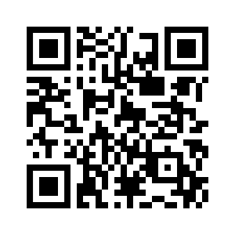
Getting Started in Overleaf and
Google Colab
https://shorturl.at/RBBeO
Contact me: https://linktr.ee/sidneygjwong
Notes:
… except for also Jurism

Slide 14
Questions???
THANK
YOU
Slides: SlidesMania
Images: Pixabay

